Slide 1
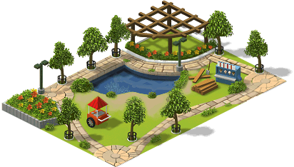

Your name

Slide 2
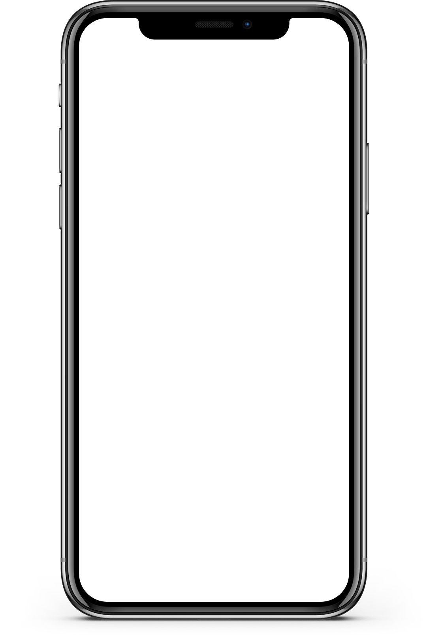
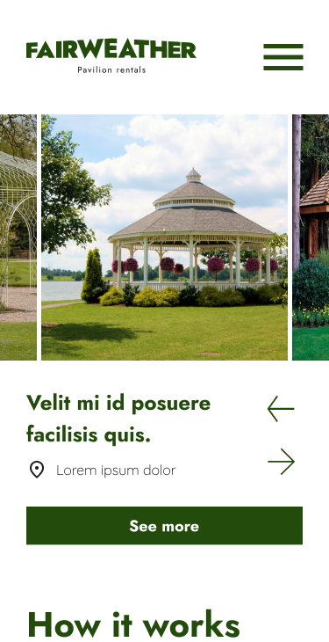
Project overview
The Product:
A pavilion rental platform that connects users of large cities who want to rent outdoor spaces for an event.
Project Duration:
8 weeks; July 2023–September 2023

Slide 3
Project overview
The Problem:
People nowadays tend to use online platforms to search for and rent outdoor event spaces, instead of going to the space directly. There are few products online specified in pavilions rental that provide a seamless, efficient and user-friendly solution for finding rental pavilions that met their budget and needs.
The Goal:
Build a digital platform specifically for pavilions search and renting experience, that can be used to connect user with different outdoor spaces available to hold events, while providing exceptional user experience.

Slide 4
Project overview
My Role:
This is an individual project that allowed me to plan and direct each step of the design thinking process as a UX strategic design student with mobile and web UI design experience.
Responsibilities:
Conduct user research
Define the problem and provide insights to inform the ideation phase
Define personas, user journeys, empathy maps, and user flows
Visual design of low-fi and high-fi wireframes, prototypes, and user testing

Slide 5
User research
Personas
Problem statements
User journey maps
Understanding
the user

Slide 6
User research: summary
To understand user frustration, needs, and requirements, I conducted a foundational research through interviews and user surveys for my project. My goal was to gain insights to understand the processes users go through to find and rent outdoor spaces, and acknowledge the importance of the product.
There are two types of user research methodologies: qualitative and quantitative research. I chose qualitative research because I had a time constraint.

Slide 7
User research: pain points
1
2
3
4
Limited online resources
Poor contact system
Limited information available
Only one way to pay
Online products and tools for pavilion rental are limited.
The actual system of contacting the pavilion´s administration does not meet users needs or accommodate their busy schedules.
Not enough details, photos, or reviews online for the available pavilions and their facilities.
Rental fees and payment methods are not limited and cannot be completed online.

Slide 8
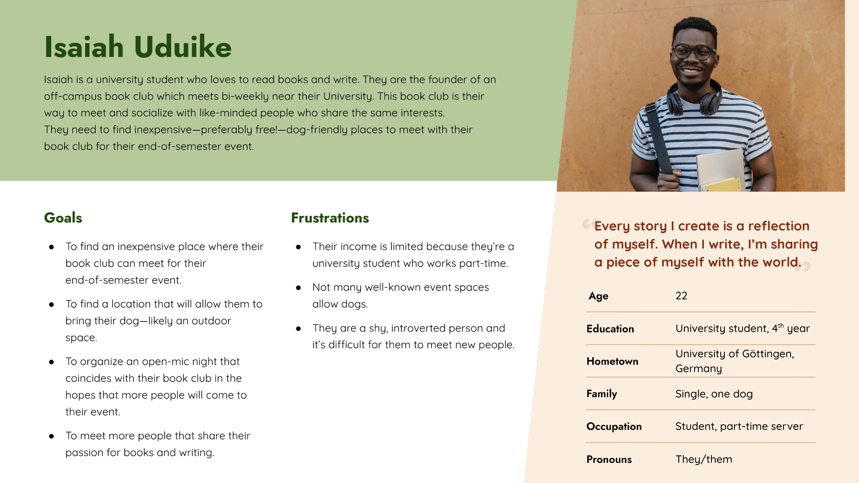
Persona: Name
Problem Statement:
Isaiah is a university student and founder of a book club who needs to find an affordable place for rent that also allows dogs to hold their book club event, and maybe an open mic night.

Slide 9
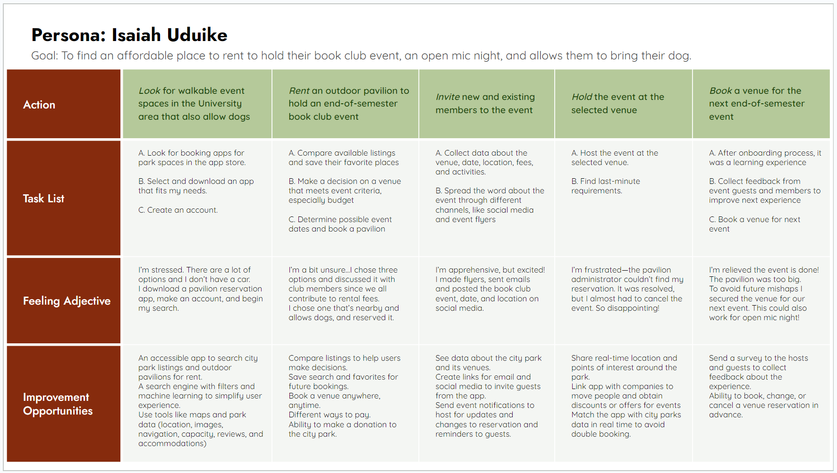
User journey map
By creating user journey maps, I wanted to illustrate the process of how Isaiah behaves, feels, and what they think while accomplishing their goals to address pain points or provide moments of delight.

Slide 10
Sitemap
Paper wireframes
Digital wireframes
Low-fidelity prototype
Usability studies
Starting
the design

Slide 11
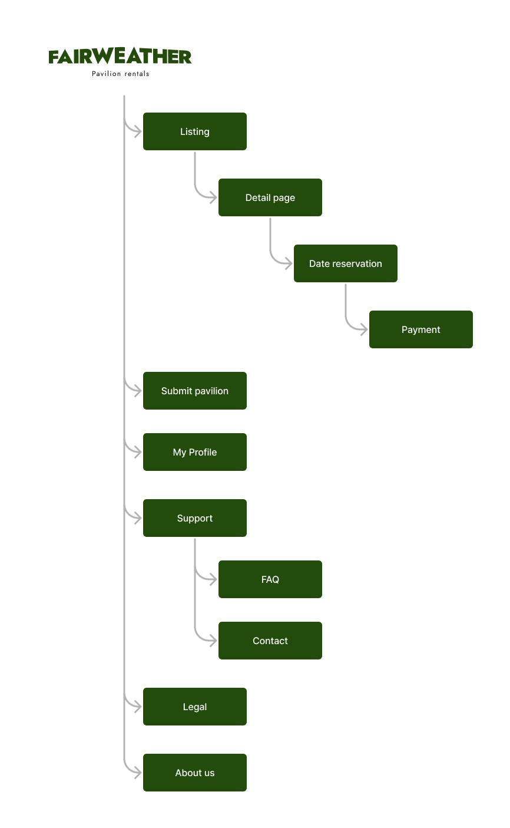
Sitemap
I built user-focused flows to ensure that my personas can successfully complete their key objectives while reducing the existing pain points.
To view a larger version of this sitemap, follow the link here.

Slide 12
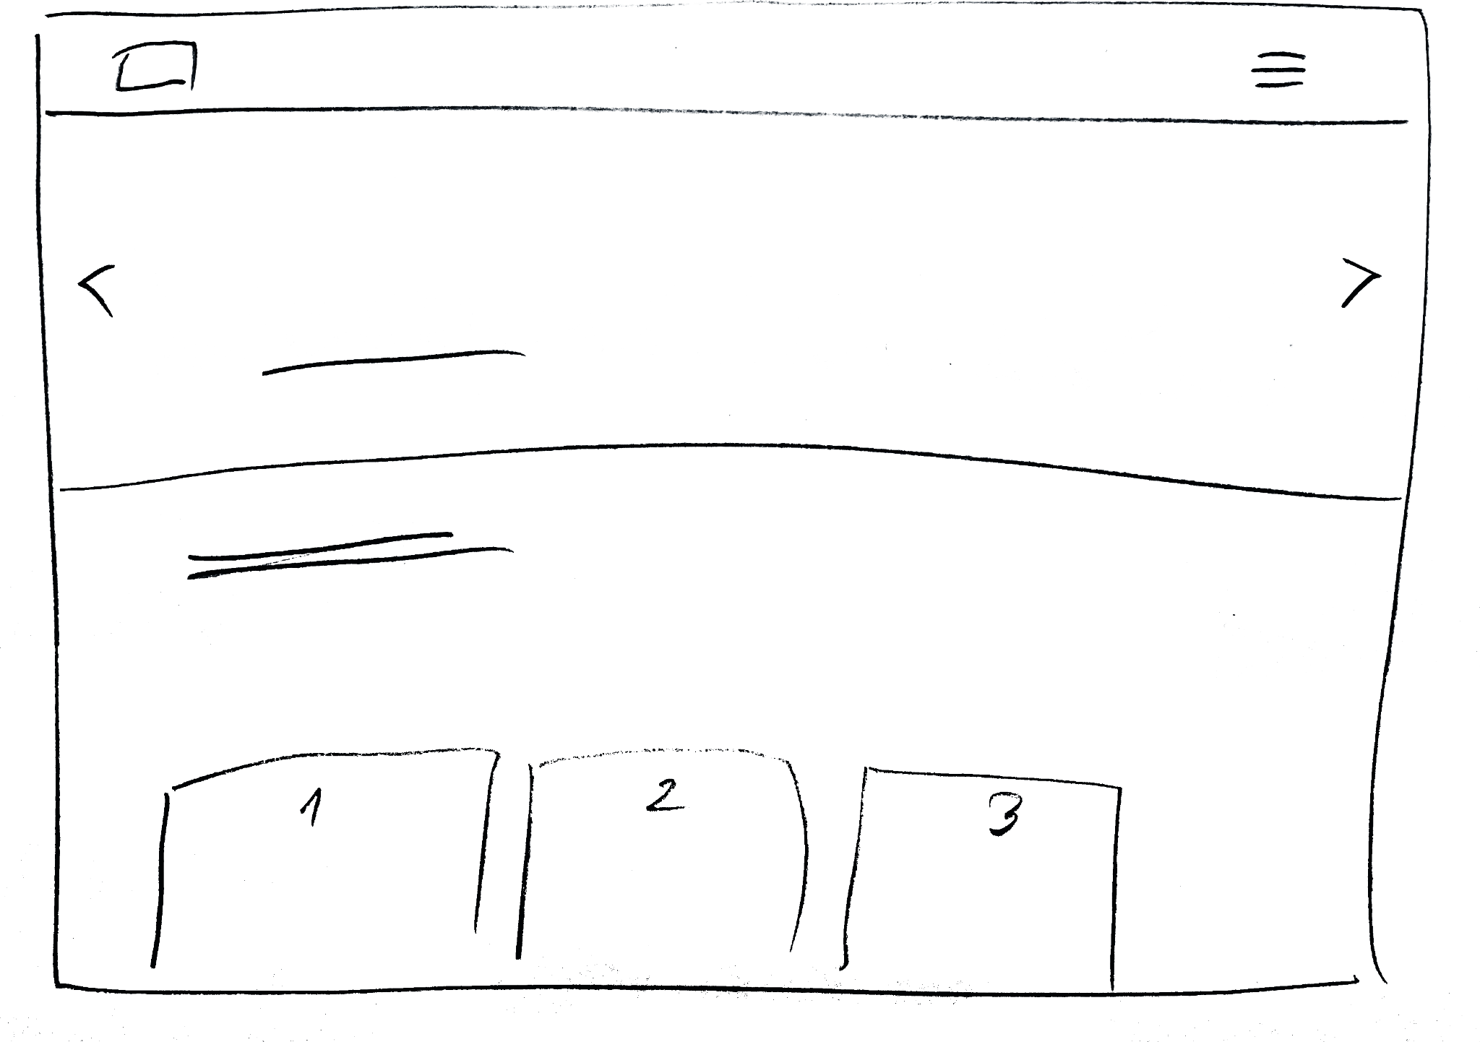
Paper wireframes
Focusing on the core features identified during user research, I sketched the first wireframes using pen and paper.

Slide 13
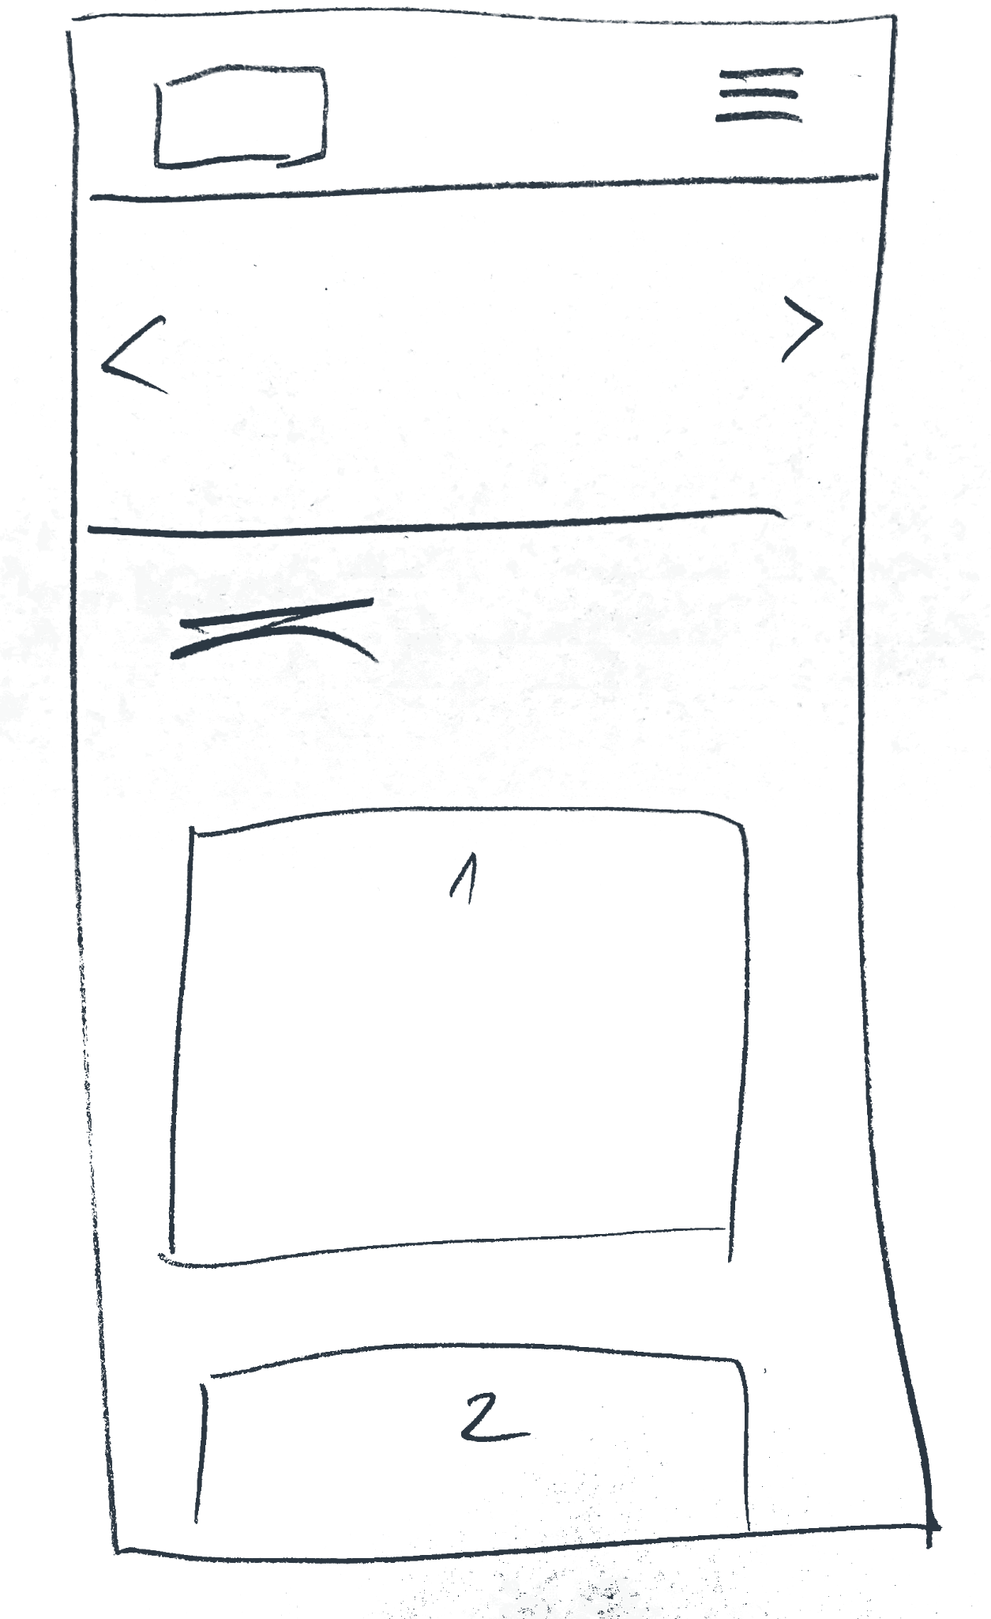
Paper wireframe
screen size variation(s)
I drafted iterations of each screen on paper.
I also started to work on designs for additional screen sizes to make sure the site would be fully responsive.

Slide 14
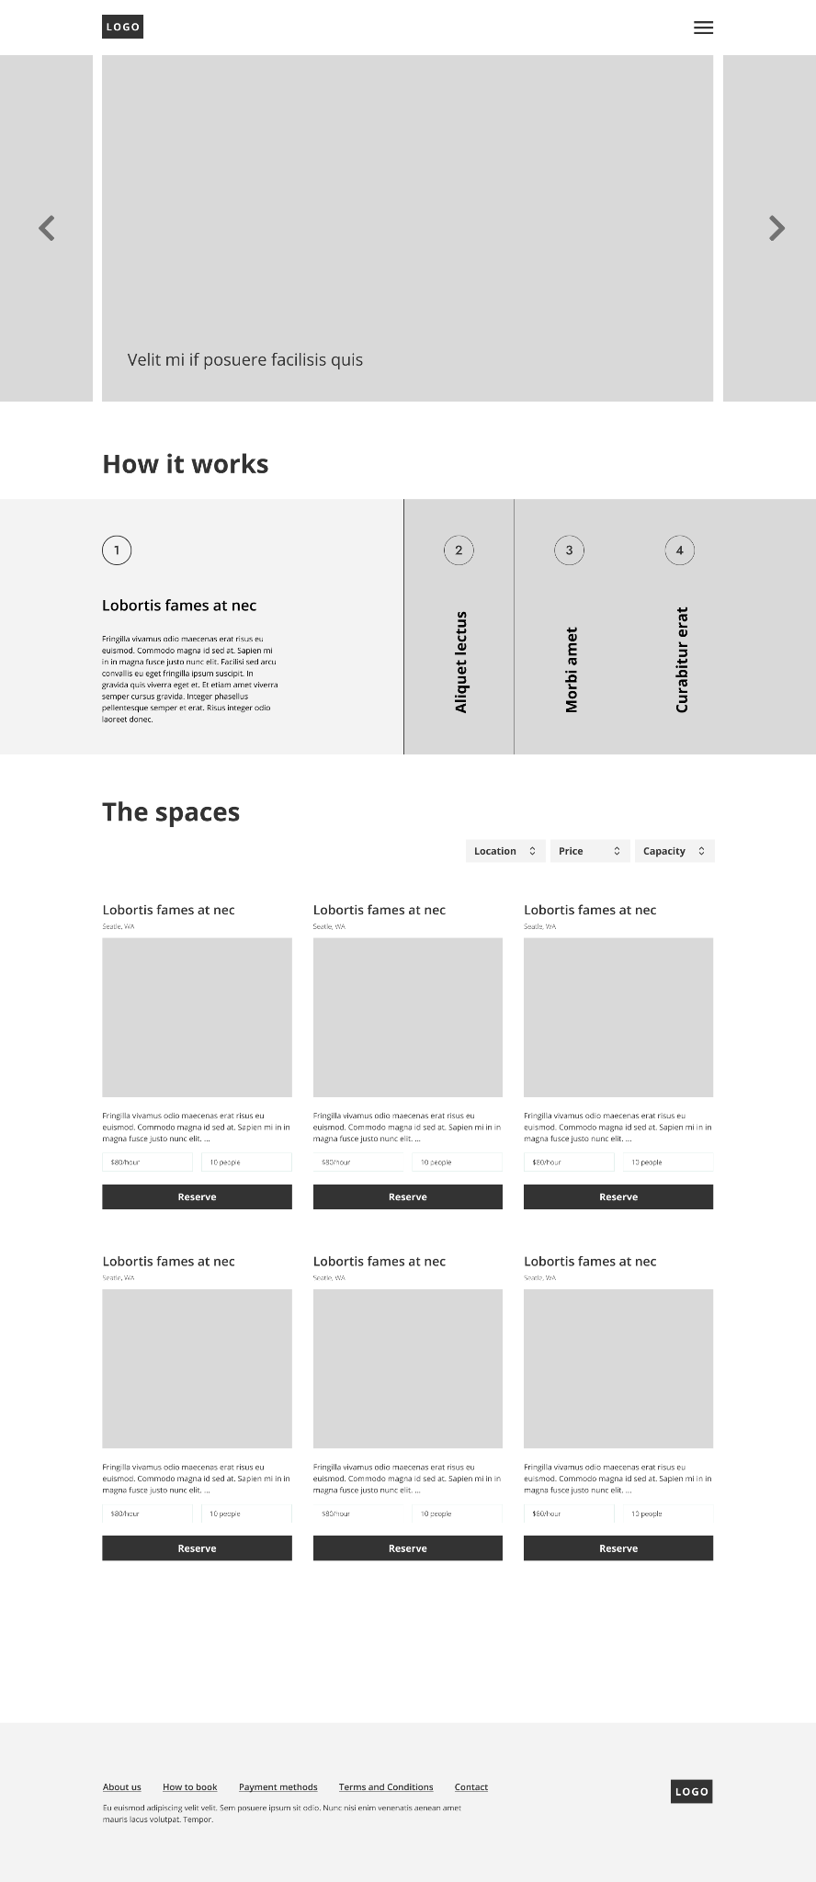
Digital wireframes
Instructions of how the process works for renting a pavilion
Using wireframes, I put my ideas on paper first and then started to make high-fidelity wireframes. After dozens of iterations, these are the wireframes that best represented user flow and met user needs.
List view of the spaces with info of the pavilions available

Slide 15
Digital wireframe
screen size variation(s)
I also started to work on digital wireframes for additional screen sizes to make sure the site would be fully responsive.

Slide 16
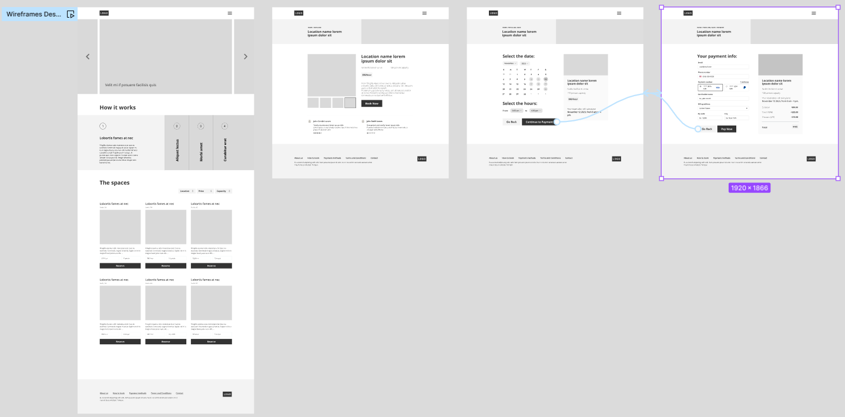
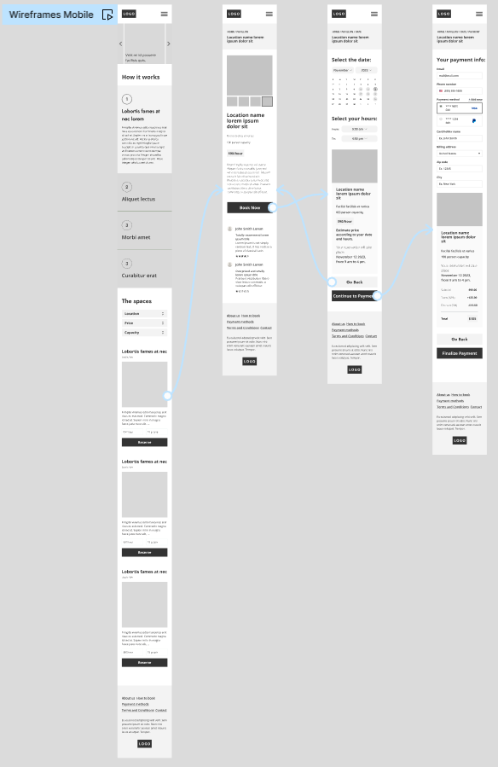
Low-fidelity prototype
I created a low-fidelity prototype from the user flow diagram and wireframes to test functionality before incorporating it into the final design and ensure accessibility for end-users.
View Prototype:
Desktop
Mobile

Slide 17
Usability study: parameters
Study Type:
Unmoderated usability study
Location:
University of Göttingen, Germany
Participants:
5 participants
Length:
20-30 minutes

Slide 18
Usability study: findings
Now that I have the key insights from the usability study, let's look at the findings and define the actual problems that a designer can solve.
1
2
3
Finding
Finding
Finding
A very large amount of information has to be displayed on the results page. I have to find the right balance so that the user isn’t overwhelmed with too much information on a page.
Most users were missing the “Search” feature because it is not over the fold. This confirmed that the search feature isn’t accessible or obvious enough. Generally, the hierarchy over the website could be improved in order to clearly state the purpose of each page.
The results page should clearly explain how the best rental has been found.
Some users expressed that it was more important to them to understand how the “best rental” was calculated more than seeing all the results.

Slide 19
Refining
the design
Mockups
High-fidelity prototype
Accessibility

Slide 20
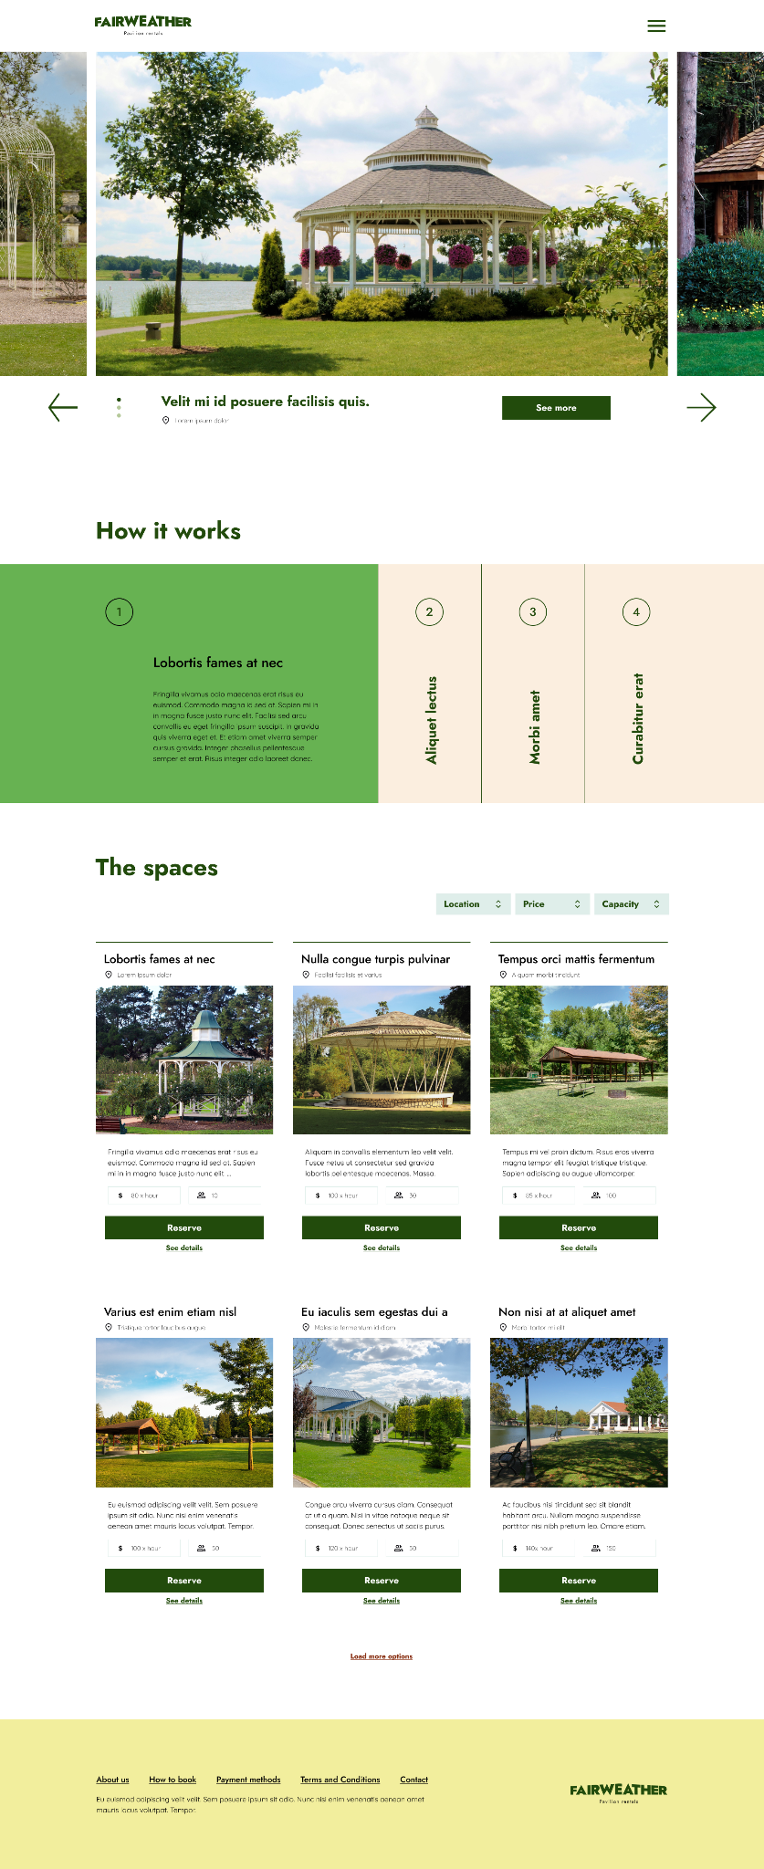
Mockups
Based on the insights from the usability studies, I applied the design changes, including a clear navigation system and search and a more straightforward flow.
Before usability study
After usability study

Slide 21
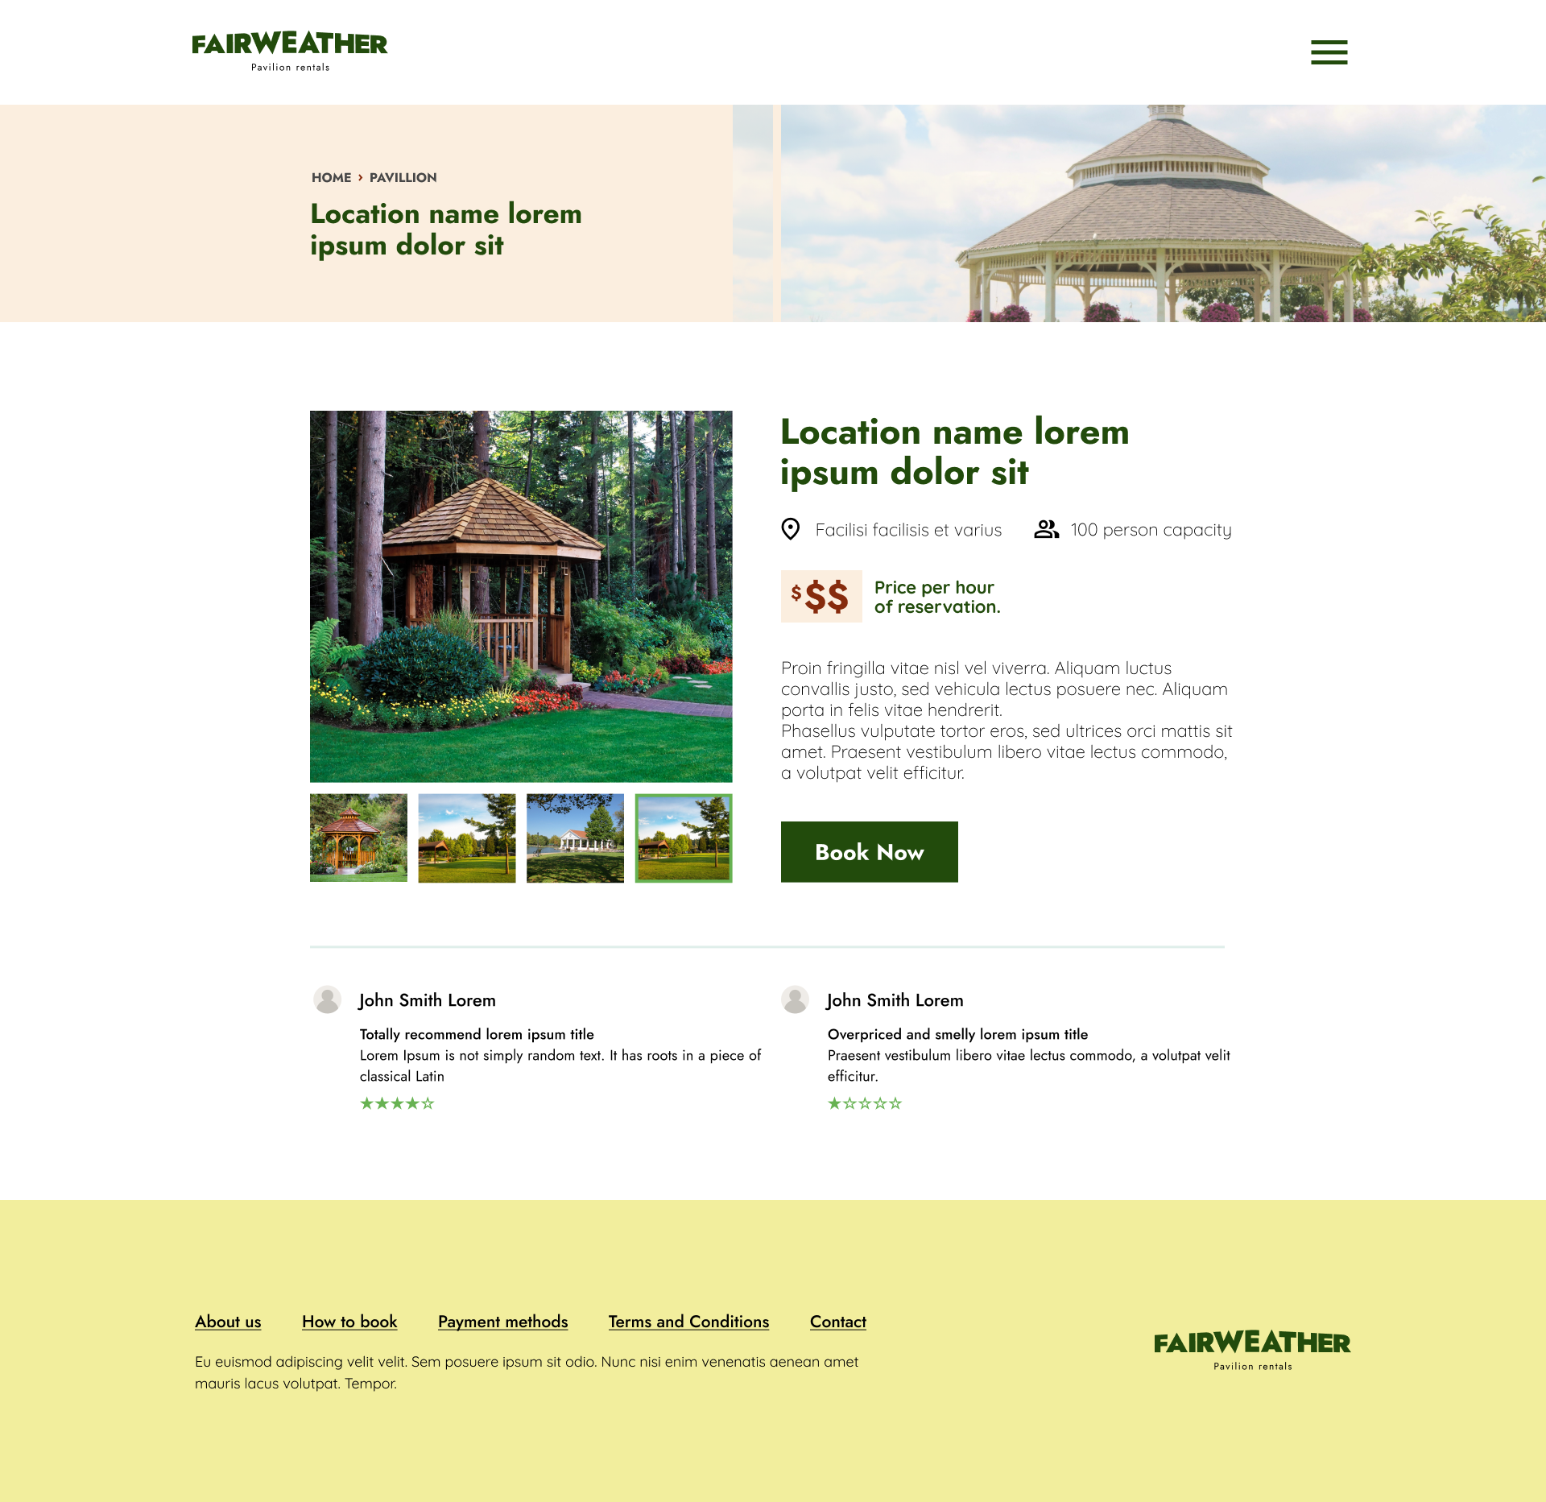
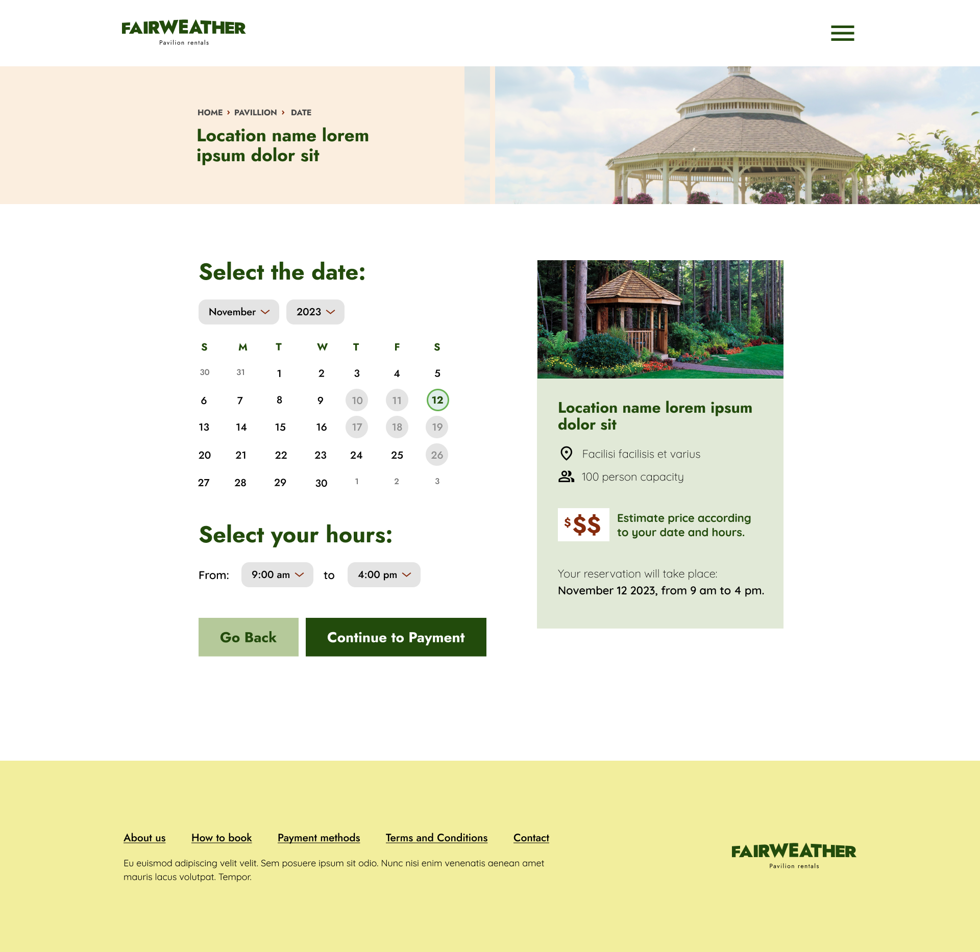
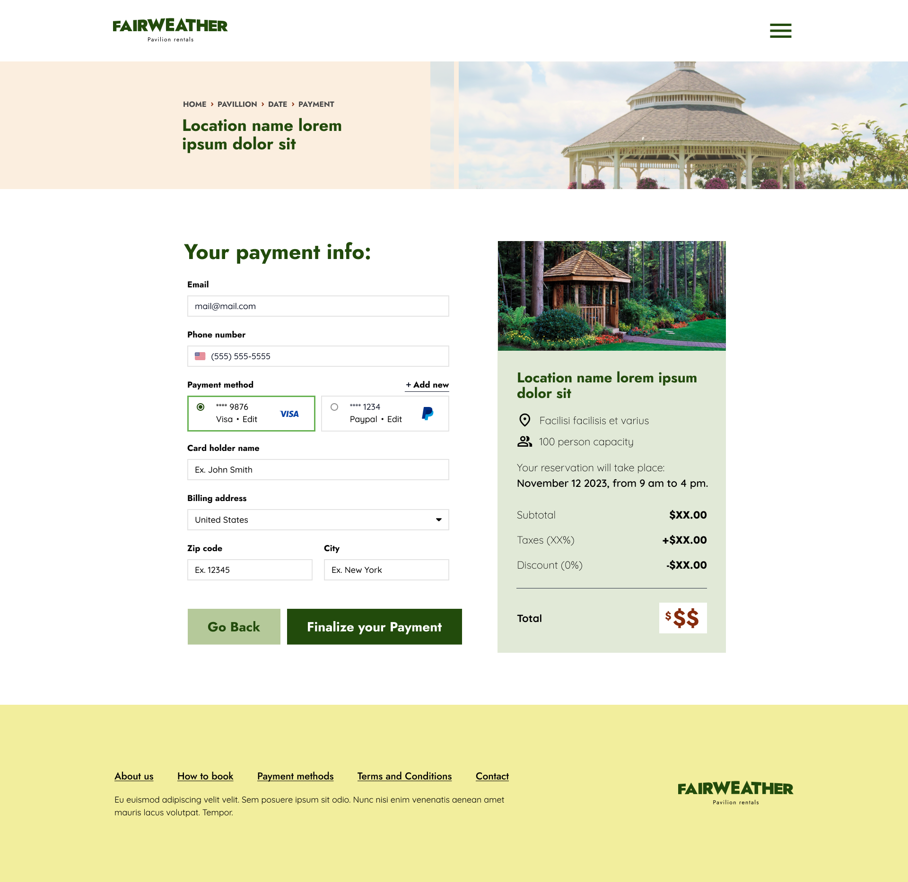
Mockups: Original screen size

Slide 22
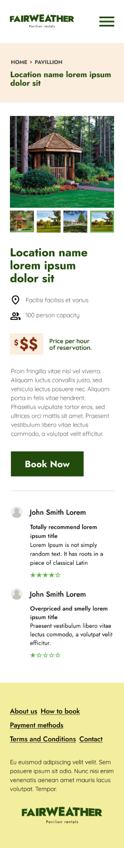
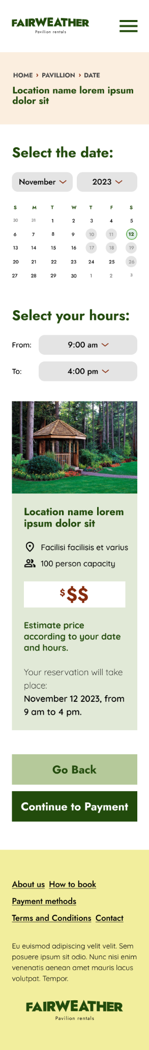
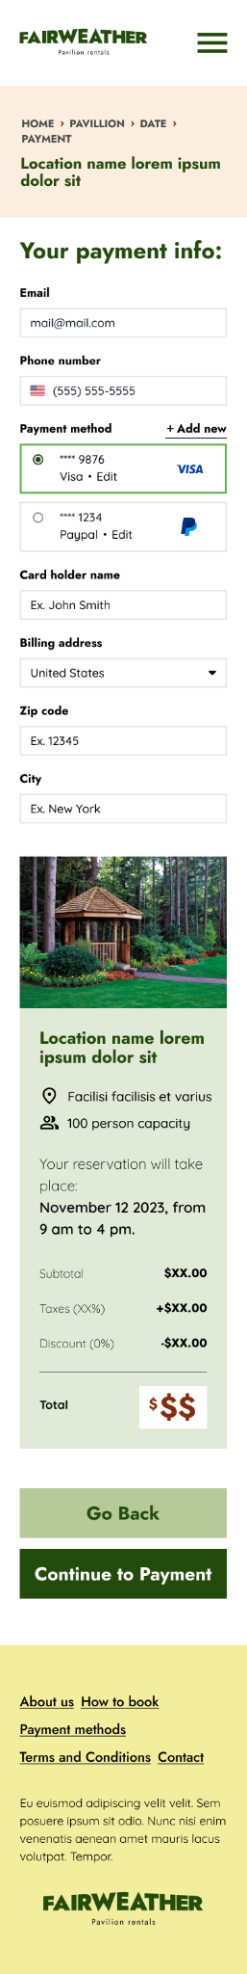
Mockups: Screen size variations

Slide 23
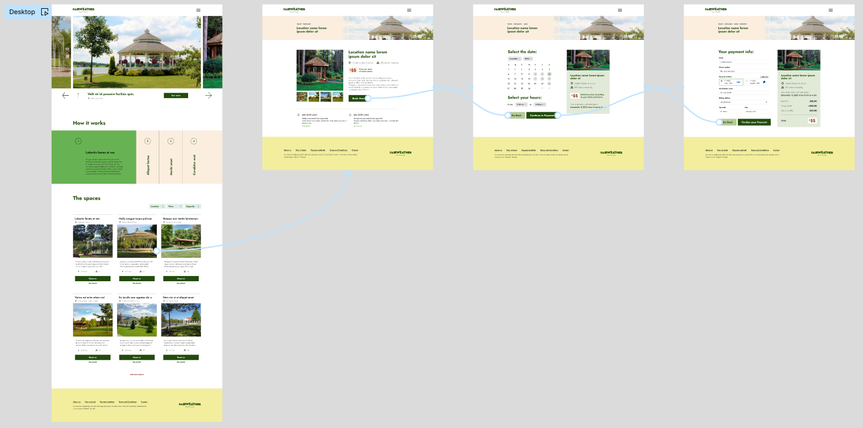
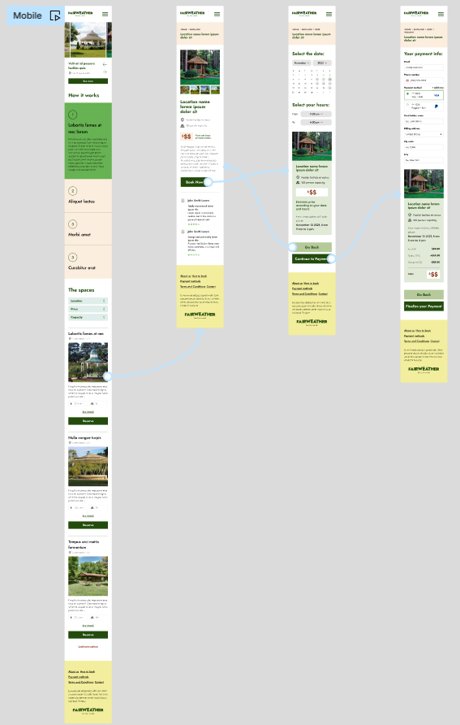
High-fidelity prototype
After finalizing the low-fidelity prototype, I worked on creating the final designs with the goal of making them more intuitive and navigable. The main color theme I used was earth toned, like greens and tans, because when you think of the environment, you think of greens and browns.
View Prototype:
Desktop
Mobile

Slide 24
Accessibility considerations
1
2
3
When choosing a color palette, I made sure my primary colors met WCAG AA Compliance before building out the UI for each screen.
I am using only two typefaces: Jost for headlines and Quicksand for body copy.
Mixing too many different typefaces can make your app seem fragmented and busy.
I implemented a text hierarchy throughout the app. This helps users to distinguish the different sections and information on screen.

Slide 25
Going forward
Takeaways
Next steps

Slide 26
Takeaways
Impact:
In this study, I aimed to address common issues faced by users and evaluate the impact of UX design on their mood and decision-making process. Through conducting this research and design, I gained a deeper understanding of how user experience can significantly influence a user’s emotions and choices.
What I Learned:
I have gained valuable insights and knowledge through the design process. Some of the key things I have learned include:
Understanding user needs
Importance of simplicity
Accessibility considerations
Understanding and implementing user feedback
Manage information to not overwhelm the user

Slide 27
Next steps
1
2
3
Obtain UX/UI feedback from designers with more experience in the field to improve design.
When I have documented all feedback that was provided, I will make the necessary design updates in order to improve the app’s overall experience.
Create a cross-platform responsive design. The goal is to build the same experience for all users, no matter what type of device they are using.

Slide 28
Let’s connect!
I would appreciate your thoughts and insights on this topic, as feedback is crucial to further enhancing the findings of this study.
Provide your contact information here. This might include your email address, phone number, and website or link to other professional platforms.

